Slide 1
Applied Management Accounting
Muscat University
Dr. Laila Al Taweel

Slide 2
5
Process Costing I
Learning Objectives
1
Discuss the uses of a process cost system and how it compares to a job order system.
2
Explain the flow of costs in a process cost system and the journal entries to assign manufacturing costs.
3
Compute equivalent units.

Slide 3
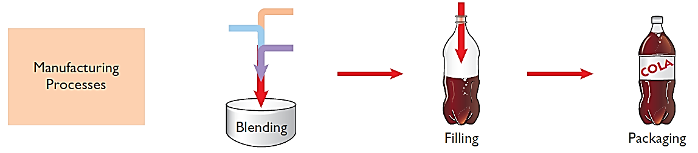
LEARNING
OBJECTIVE
Discuss the uses of a process cost system and how it compares to a job order system.
1
Uses of Process Cost Systems
Use to apply costs to similar products that are mass-produced in a continuous fashion.
Examples include the production of Cereal, Paint, Manufacturing Steel, Oil Refining and Soft Drinks.
Illustration 3-1
Manufacturing processes
LO 1

Slide 4
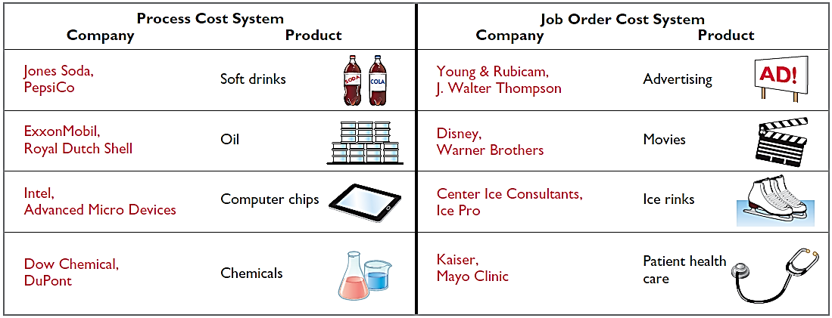
Use of Process Cost Systems
Examples of companies that primarily use either a process cost system or a job order cost system.
Illustration 3-2
Process cost and job order cost
companies and products
LO 1

Slide 5
Use of Process Cost Systems
Question
Which of the following items is not a characteristic of a process cost system:
Once production begins, it continues until the finished product emerges.
The focus is on continually producing homogenous products.
When the finished product emerges, all units have precisely the same amount of materials, labor, and overhead.
The products produced are heterogeneous in nature.
LO 1

Slide 6
Process Cost for Service Companies
Service companies that provide individualized, nonroutine services will probably benefit from using a job order cost system.
Those that perform routine, repetitive services will probably be better off with a process cost system.
LO 1

Slide 7
Similarities and Differences Between Job Order Cost and Process Cost Systems
Job Order Cost
Costs assigned to each job.
Products have unique characteristics.
Process Cost
Costs tracked through a series of connected manufacturing processes or departments.
Products are uniform or relatively homogeneous and produced in a large volume.
LO 1

Slide 8
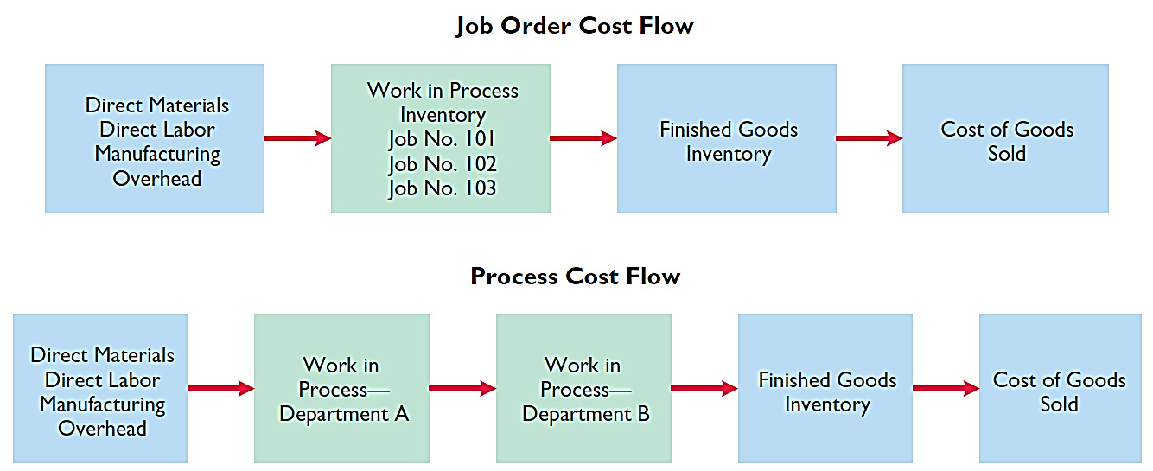
Job Order Cost and Process Cost Flow
Illustration 3-3
Job order cost and process cost flow
LO 1

Slide 9
Job Order Cost and Process Cost Flow
Similarities
Differences
Manufacturing cost elements.
Accumulation of the costs of materials, labor, and overhead.
Flow of costs.
Number of work in process accounts used.
Documents used to track costs.
Point at which costs are totaled.
Unit cost computations.
LO 1

Slide 10
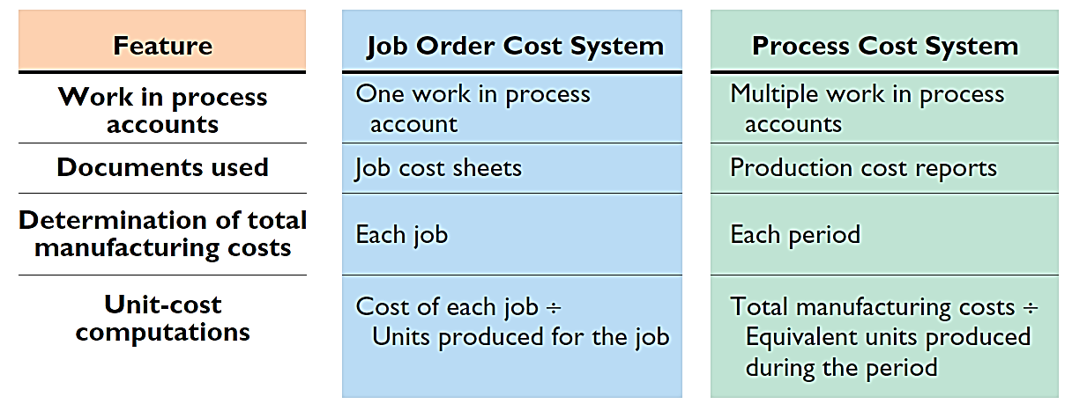
Job Order Cost and Process Cost Flow
Illustration 3-4
Job order versus process cost systems
LO 1

Slide 11
Use of Process Cost Systems
Question
Indicate which of the following statements is not correct:
Both a job order and a process cost system track the same three manufacturing cost elements – direct materials, direct labor, and manufacturing overhead.
b. In a job order cost system, only one work in process account is used, whereas in a process cost system, multiple work in process accounts are used.
c. Manufacturing costs are accumulated the same way in a job order and in a process cost system.
d. Manufacturing costs are assigned the same way in a job order and in a process cost system.
LO 1

Slide 12
1
Compare Job Order and Process Cost Systems
Indicate whether the following statements are true or false.
A law firm is likely to use process costing for major lawsuits.
A manufacturer of paintballs is likely to use process costing.
Both job order and process costing determine product costs at the end of a period of time, rather than when a product is completed.
Process costing does not keep track of manufacturing overhead.
False
True
False
False
LO 1

Slide 13
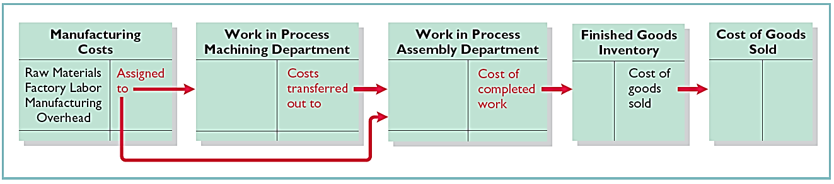
LEARNING
OBJECTIVE
Explain the flow of costs in a process cost system and the journal entries to assign manufacturing costs.
2
Process Cost Flow
Tyler Company manufactures roller blade and skateboard wheels that it sells to manufactures and retail outlets. Manufacturing consists of two processes: machining and assembly. The Machining Department shapes, hones, and drills the raw materials. The Assembly Department assembles and packages the parts.
Illustration 3-5
Flow of costs in process cost system
LO 2

Slide 14
Assigning Manufacturing Costs
Accumulation of the cost of materials, labor, and overhead is the same as in job order costing.
Debit Raw Materials Inventory for purchases of raw materials.
Debit Factory Labor for factory labor incurred.
Debit Manufacturing Overhead for overhead cost incurred.
Assignment of the three manufacturing cost elements to Work in Process in a process cost system is different from a job order cost system.
LO 2

Slide 15
Assigning Manufacturing Costs
Material Costs
A process cost system requires fewer material requisition slips than a job order cost system.
Materials are used for processes and not specific jobs.
Requisitions are for larger quantities of materials.
Journal entry to record materials used:
Work in Process—Machining XXXXX
Work in Process—Assembly XXXXX
Raw Materials Inventory XXXXX
LO 2

Slide 16
Assigning Manufacturing Costs
Factory Labor Costs
Time tickets may be used in both systems.
All labor costs incurred within a production department are a cost of processing.
The journal entry to record factory labor costs:
Work in Process—Machining XXXXX
Work in Process—Assembly XXXXX
Factory Labor XXXXX
LO 2

Slide 17
Assigning Manufacturing Costs
Manufacturing Overhead Costs
Objective of assigning overhead is to allocate overhead to production departments on objective and equitable basis.
Use the activity that “drives” or causes the costs.
Machine time used - primary driver.
Journal entry to allocate overhead:
Work in Process—Machining XXXXX
Work in Process—Assembly XXXXX
Manufacturing Overhead XXXXX
LO 2

Slide 18
Assigning Manufacturing Costs
Transfers
Monthly Entry to transfer goods to next department:
Work in Process—Assembly XXXXX
Work in Process—Machining XXXXX
Entry to transfer completed goods to Finished Goods:
Finished Goods Inventory XXXXX
Work in Process—Assembly XXXXX
Entry to record Cost of Goods sold at the time of sale:
Cost of Goods Sold XXXXX
Finished Goods Inventory XXXXX
LO 2

Slide 19
Assigning Manufacturing Costs
Question
In making the journal entry to assign raw materials costs:
a. The debit is to Finished goods Inventory.
b. The debit is often to two or more work in process accounts.
c. The credit is generally to two or more work in process accounts.
d. The credit is to Finished Goods Inventory.
LO 2

Slide 20

2
Manufacturing Costs in Process Costing
Blue Diamond Company manufactures ZEBO through two processes: blending and bottling. In June, raw materials used were Blending $18,000 and Bottling $4,000. Factory labor costs were Blending $12,000 and Bottling $5,000. Manufacturing overhead costs were Blending $6,000 and Bottling $2,500. The company transfers units completed at a cost of $19,000 in the Blending Department to the Bottling Department. The Bottling Department transfers units completed at a cost of $11,000 to Finished Goods. Journalize the assignment of these costs to the two processes and the transfer of units as appropriate.
LO 2

Slide 21
2
Manufacturing Costs in Process Costing
Journalize the assignment of these costs to the two processes.
To Record Materials Used:
Work in Process—Blending 18,000
Work in Process—Bottling 4,000
Raw Materials Inventory 22,000
To Assign Factory Labor to Production:
Work in Process—Blending 12,000
Work in Process—Bottling 5,000
Factory Labor 17,000
LO 2

Slide 22
2
Manufacturing Costs in Process Costing
Journalize the assignment of these costs to the two processes.
To Assign Overhead to Production:
Work in Process—Blending 6,000
Work in Process—Bottling 2,500
Manufacturing Overhead 8,500
LO 2

Slide 23
2
Manufacturing Costs in Process Costing
Journalize the transfer of units as appropriate.
To Record Transfer of Units to the Bottling Department:
Work in Process—Bottling 19,000
Work in Process—Blending 19,000
To Record Transfer of Units to Finished Goods:
Finished Goods Inventory 11,000
Work in Process—Bottling 11,000
LO 2

Slide 24
LEARNING
OBJECTIVE
Compute equivalent units.
3
Illustration: Suppose you have a work-study job in the office of your college’s president, and she asks you to compute the cost of instruction per full-time equivalent student at your college. The college’s vice president for finance provides the following information.
Illustration 3-6
Information for full-time
student example
Costs:
Total cost of instruction $9,000,000
Student population:
Full-time students 900
Part-time students 1,000
LO 3

Slide 25
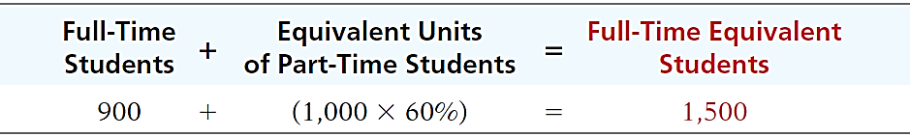
Compute Equivalent Units
Illustration: Part-time students take 60% of the classes of a full-time student during the year. To compute the number of full-time equivalent students per year, you would make the following computation.
Illustration 3-7
Full-time equivalent unit computation
Cost of instruction per full-time equivalent student =
Total cost of instruction $9,000,000
Number of full-time equivalent students ÷ 1,500
$ 6,000
LO 3

Slide 26
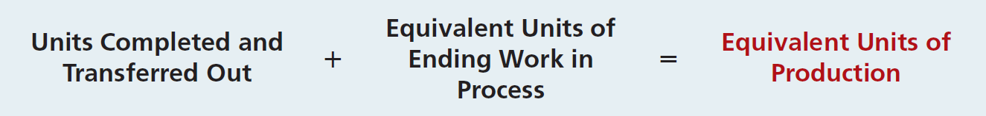
Weighted-Average Method
Considers the degree of completion (weighting) of units completed and transferred out and units in ending work in process.
Most widely used method.
Beginning work in process not part of computation of equivalent units.
Illustration 3-8
Equivalent units of production
formula
LO 3

Slide 27
Weighted-Average Method
Illustration: The output of Kori Company’s Packaging Department during the period consists of 10,000 units completed and transferred out, and 5,000 units in ending work in process which are 70% completed.
Calculate the equivalent units of production.
Completed units 10,000
Work in process equivalent units (5,000 x 70%) 3,500
13,500
LO 3

Slide 28
Refinements on the Weighted-Average Method
Illustration: Kellogg Company has produced Eggo® Waffles since 1970. Three departments produce these waffles: Mixing, Baking, and Freezing/Packaging. The Mixing Department combines dry ingredients, including flour, salt, and baking powder, with liquid ingredients, including eggs and vegetable oil, to make waffle batter.
Illustration 3-9 provides information related to the Mixing Department at the end of June.
LO 3

Slide 29
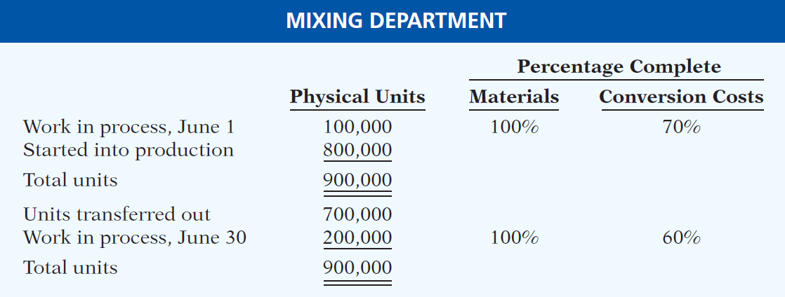
Refinements Weighted-Average Method
Illustration: Information related to the Mixing Department at the end of June.
Illustration 3-9
Information for Mixing
Department
LO 3

Slide 30
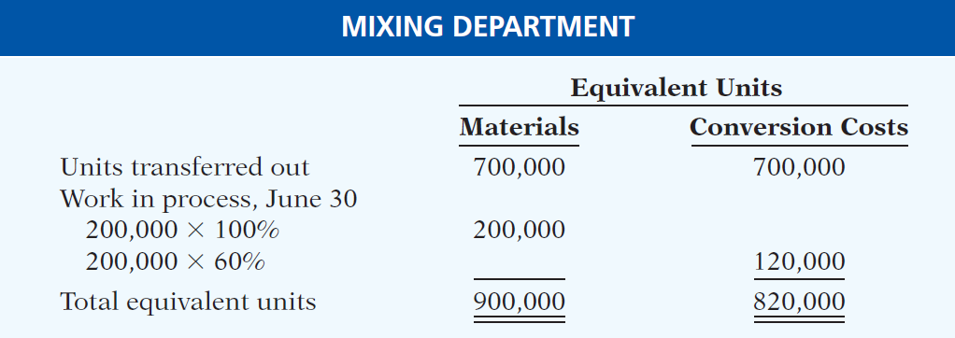
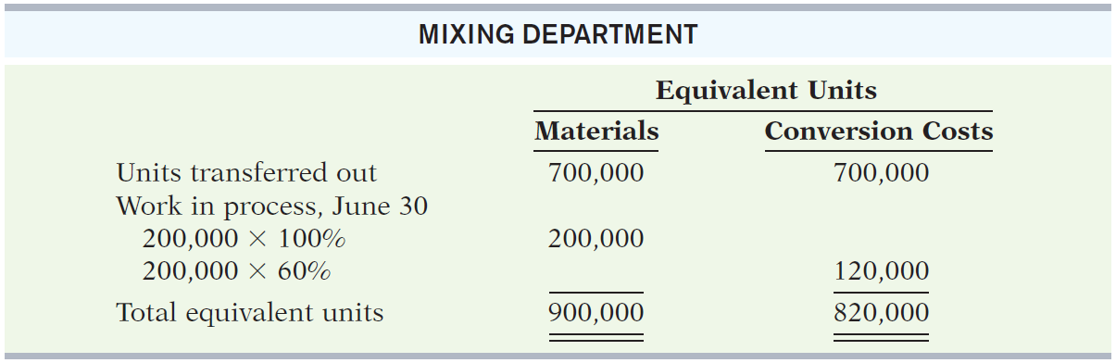
Refinements Weighted-Average Method
Conversion costs are labor costs plus overhead costs.
Beginning work in process is not part of the equivalent-units-of-production formula.
Illustration 3-10
Computation of equivalent
units—Mixing Department
LO 3

Slide 31
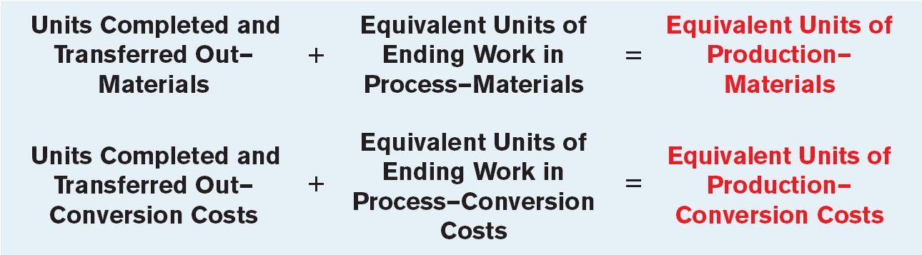
Refinements Weighted-Average Method
Illustration 3-11
Refined equivalent units of production formula
LO 3

Slide 32
Compute Equivalent Units
Question
The Mixing Department’s output during the period consists of 20,000 units completed and transferred out, and 5,000 units in ending work in process 60% complete as to materials and conversions costs. Beginning inventory is 1,000 units, 40% complete as to materials and conversion costs. The equivalent units of production are:
a. 22,600 b. 23,000
c. 24,000 d. 25,000
LO 3

